Slide 1
Content of Lecture
Structured Query Language (SQL)
History of SQL
Manipulating Databases Using SQL

Slide 2
Introduction
SQL is also pronounced as “Sequel”
A de-facto standard for relational DBMS
The standard accepted by bodies like ANSI and ISO

Slide 3
Introduction
The first commercial DBMS that supported SQL in 1979 was Oracle
Another form of query language is Query-by-Example (QBE) supported by PC-based DBMSs

Slide 4
History
Relational data model introduced by Codd in 1970
A relational DBMS project started by IBM was System R which included a sequel as a manipulation language

Slide 5
History
The first commercial DBMS launched was Oracle in 1979
Other early DBMSs DB2, INGRES
ANSI and ISO defined the first standard of SQL in 1986 known as SQL-86 which was further extended to SQL-89

Slide 6
History
Later two more standards known as SQL-92 and SQL-99 were defined
Almost all of the current DBMSs support SQL-92 and many support SQL-99 partially or completely
SQL today is supported in all sort of machines

Slide 7
Benefits of Standard SQL
Reduced training cost
Application portability
Application longevity
Reduced dependence on a single vendor
Cross-system communication

Slide 8
SQL
SQL is used for any type of interaction with the database through DBMS
Right from creating a database, tables, views, users
Insertion, updation, and deletion of data in the database

Slide 9
SQL and DBMSs
Implementation of SQL always includes the flavor of the particular DBMS, like in the names of data types
Proprietary SQLs exist, like T-SQL and PL-SQL

Slide 10
DBMS
The DBMS for our course is Oracle Database and MySQL

Slide 11
INTRODUCTION
A programing language is designed to communicate a series of instructions so that those instructions can be executed
In the field of IT, programming languages are used to communicate with computer hardware and software
  E.g. To create new computer programs
  E.g. To direct computer programs to take certain actions

Slide 12
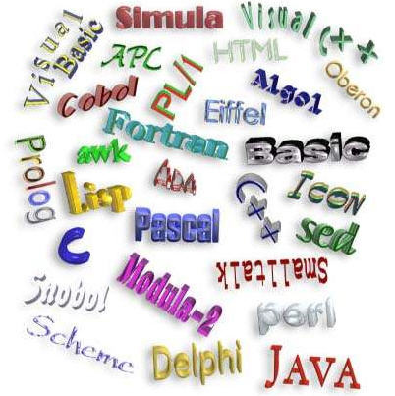
INTRODUCTION
Over the years, many programming languages have been created, each with its advantages and disadvantages
Figure 01

Slide 13

Structured Query Language (SQL)
The structured query language (SQL) is the standard programming language for interacting with the relational database management system (RDBMS)
RDBMS
instructions using SQL

Slide 14

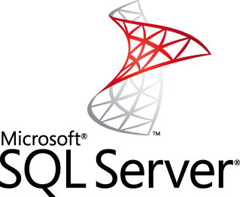
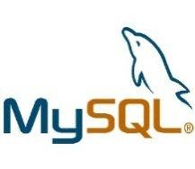
Structured Query Language (SQL)
As SQL is a standard, is supported by all the major RDBMS vendors.
…
instructions using SQL

Slide 15
Structured Query Language (SQL)
According to the standard, SQL can be thought of as consisting of two major components
SQL
DDL (Data Definition Language)
  Defining the database structure (e.g. defining tables needed) and controlling access to the data (e.g. Create/alter/delete)
DML (Data Manipulation Language)
Retrieving and modifying data

Slide 16
Manipulating Databases Using SQL
There are three ways that one can manipulate databases using SQL
Create a database
List the databases
Delete a database

Slide 17
Manipulating Databases Using SQL
Create a database
You should always end an SQL statement with a semicolon
SQL syntax:
For example, to create a database named “Amazon”
CREATE DATABASE <database_name>;
CREATE DATABASE Amazon;

Slide 18
Manipulating Databases Using SQL
List the databases
SQL syntax:
For example, to see a list of all the databases that have been created in MySQL
SHOW DATABASES;
SHOW DATABASES;

Slide 19
Manipulating Databases Using SQL
Delete a database
SQL syntax:
For example, to delete the database named “Amazon”
DROP DATABASE <database_name>;
DROP DATABASE Amazon;

